Slide 1
Comparison Chart of question 3
Models used are resnet , vgg16 and CNN
(NO result is plotted for CNN in this presentation but .ipynb file is added on git hub)

Slide 2
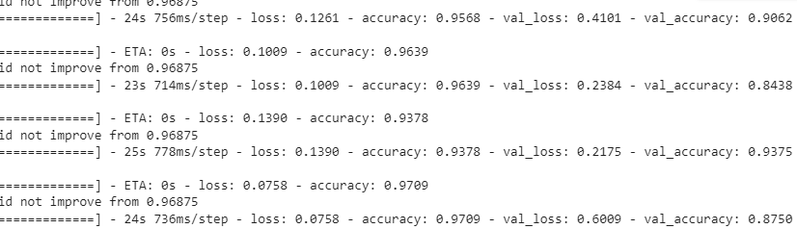
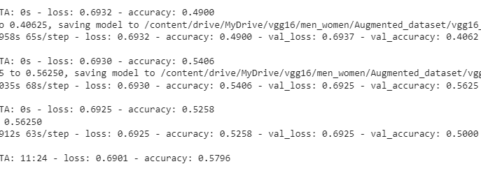
Vgg16 (Original and Augmented data)
While training the vgg16 model the weights are not copied from keras it is purely custom project. All the weights are found through the training only.
Original Dataset
Augmented dataset

Slide 3
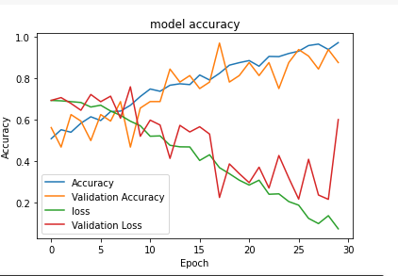
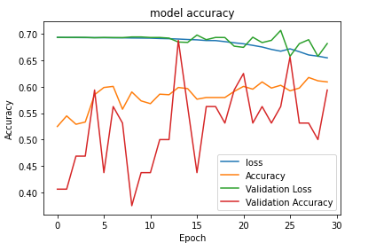
Plots of Original vs Augmented dataset
Original dataset
Augmented Dataset

Slide 4
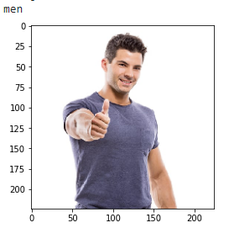
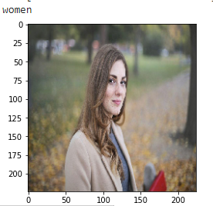
Prediction Original vs Augmented
Prediction of original dataset Model
Prediction of Augmented dataset model

Slide 5
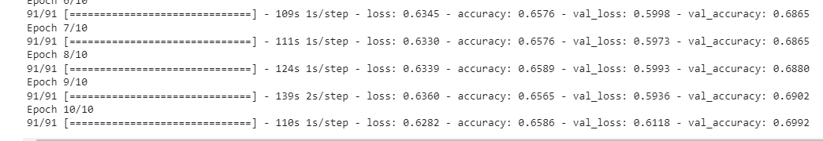
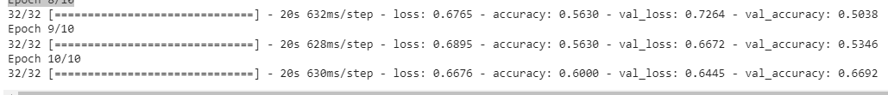
ResNet50 (Original and Augmented Data)
Accuracy at the end of the epochs
Original dataset
Augmented dataset

Slide 6
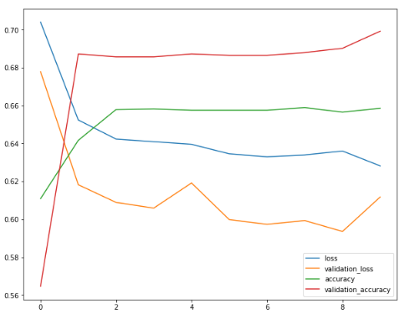
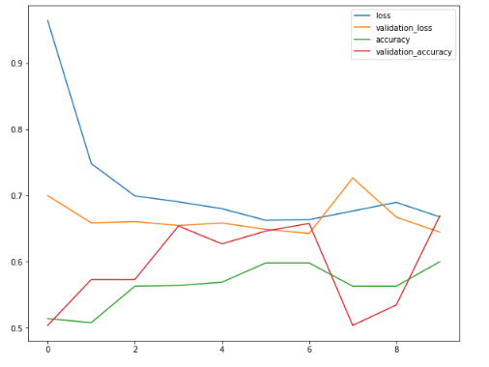
Plots of Original vs Augmented dataset
Original Datase
Augmented Dataset

